Slide 1
Gauss’s Law

Slide 2
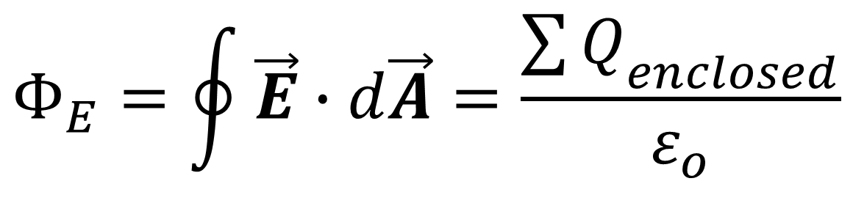
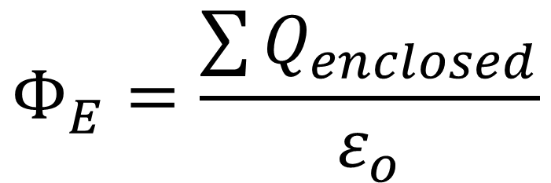
General form of Gauss’s law
Gauss’s law states that the total electric flux through a closed surface is equal to the total (net) electric charge inside the surface, divided by permittivity of free space, ε_{o.}
$$Φ_{E}=\frac{\sum{Q_{enclosed}}}{ε_{o}}$$
$$Φ_{E}=\oint{\vec{E}∙d\vec{A}=\frac{{\sum{Q}}_{enclosed}}{ε_{o}}}$$

Slide 3
Field between oppositely charged parallel conducting plates
Two large plane parallel conducting plates are given charges of equal magnitude and opposite sign; the surface charge densities are +σ and -σ. Find the electric field in the region between the plates.

Slide 5
The left-hand end of surface S₁ is within the positive plate 1. Since the field is zero within the volume of any solid conductor under electrostatic conditions, there is no electric flux
through this end.
The electric field between the plates is perpendicular to the right-hand end, and the flux is EA; this is positive, since E is directed out of the Gaussian surface.

Slide 6
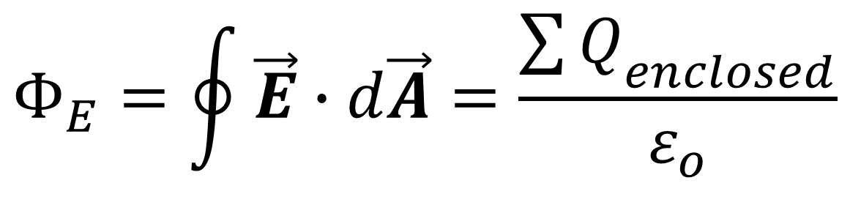
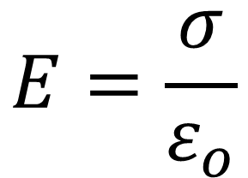
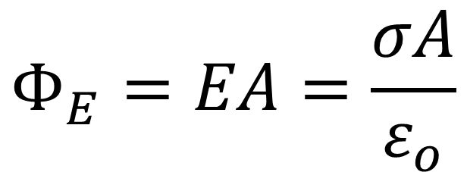
$$Φ_{E}=\oint{\vec{E}∙d\vec{A}=\frac{{\sum{Q}}_{enclosed}}{ε_{o}}}$$
$$Φ_{E}=EA=\frac{σA}{ε_{o}}$$
$$E=\frac{σ}{ε_{o}}$$
(field between oppositely charged conducting plates)

Slide 7
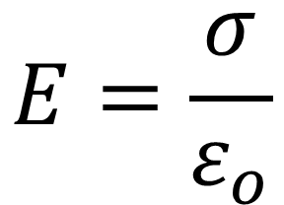
Surfaces S₂ and S₃ yield E = 0 to the left of plate 1 and to the right of plate 2, respectively.
The Gaussian surface S₄ yields the same result
$$E=\frac{σ}{ε_{o}}$$

Slide 8
FIELD OF A UNIFORMLY CHARGED SPHERE
Positive electric charge Q is distributed uniformly throughout the volume of an insulating sphere with radius R. Find the magnitude of the electric field at a point P a distance r from the center of the sphere.

Slide 9
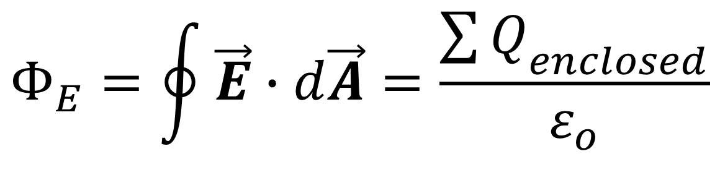
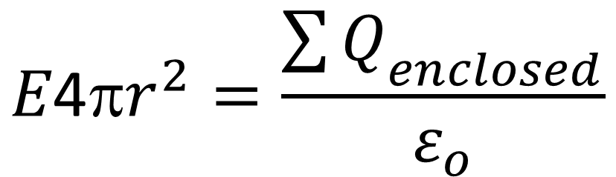
the direction of E is radial at every point on the Gaussian surface
the field magnitude E is the same at every point on the surface
$$Φ_{E}=\oint{\vec{E}∙d\vec{A}=\frac{{\sum{Q}}_{enclosed}}{ε_{o}}}$$
$$E\text{4π}r^{2}=\frac{{\sum{Q}}_{enclosed}}{ε_{o}}$$

Slide 10
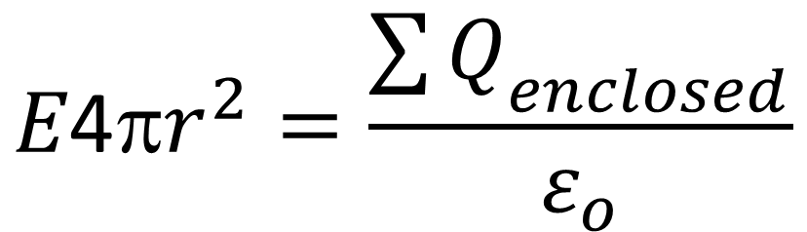
$$E\text{4π}r^{2}=\frac{{\sum{Q}}_{enclosed}}{ε_{o}}$$
The amount of charge enclosed within the Gaussian surface depends on r. To find E inside the sphere, we choose r < R.
The volume enclosed by the Gaussian surface is 4/3πr³

Slide 11
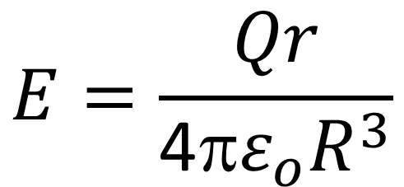
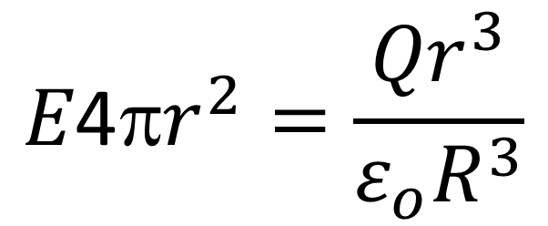
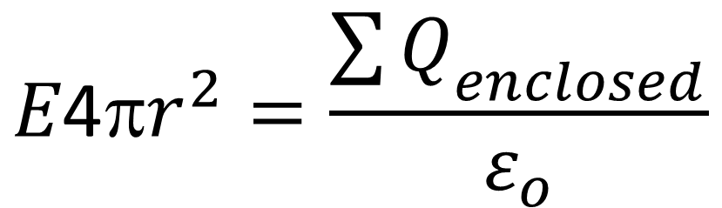
$$E\text{4π}r^{2}=\frac{{\sum{Q}}_{enclosed}}{ε_{o}}$$
$$E\text{4π}r^{2}=\frac{{Qr}^{3}}{ε_{o}R^{3}}$$
$$E=\frac{Qr}{\text{4π}ε_{o}R^{3}}$$
(field inside a uniformly charged sphere)

Slide 12
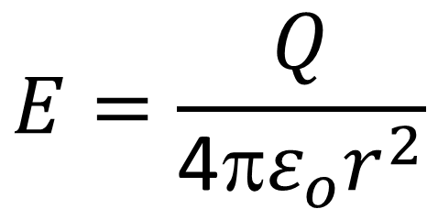
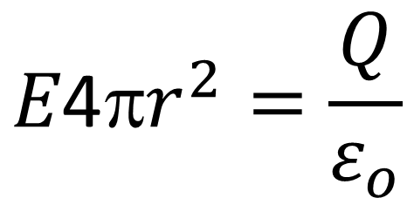
To find E outside the sphere, we take r > R.
$$E\text{4π}r^{2}=\frac{{\sum{Q}}_{enclosed}}{ε_{o}}$$
$$E\text{4π}r^{2}=\frac{Q}{ε_{o}}$$
$$E=\frac{Q}{\text{4π}{ε_{o}r}^{2}}$$
(field outside a uniformly charged sphere)

Slide 14
CHARGE ON A HOLLOW SPHERE
A thin-walled, hollow sphere of radius 0.250 m has an unknown
charge distributed uniformly over its surface. At a distance of
0.300 m from the center of the sphere, the electric field points
radially inward and has magnitude 1.80 x 10² N/C. How much
charge is on the sphere?

Slide 16

Charges on conductors
Consider a solid conductor with a hollow cavity inside.
If there is no charge within the cavity, we can use a Gaussian surface such as A to show that the net charge on the surface of the cavity must be zero, because = 0 everywhere on the Gaussian surface.

Slide 17
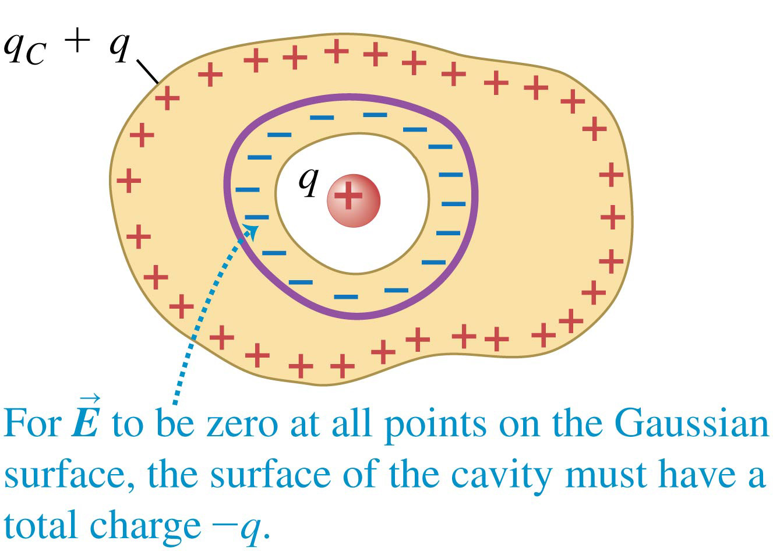
Charges on conductors
Suppose we place a small body with a charge q inside a cavity within a conductor. The conductor is uncharged and is insulated from the charge q.
According to Gauss’s law the total there must be a charge −q distributed on the surface of the cavity, drawn there by the charge q inside the cavity.
The total charge on the conductor must remain zero, so a charge +q must appear on its outer surface.

Slide 18
A CONDUCTOR WITH A CAVITY
A conductor with a cavity carries a total charge of +7 nC. Within the cavity, insulated from the conductor, is a point charge of -5 nC. How much charge is on each surface (inner and outer) of the conductor?

